Slide 1
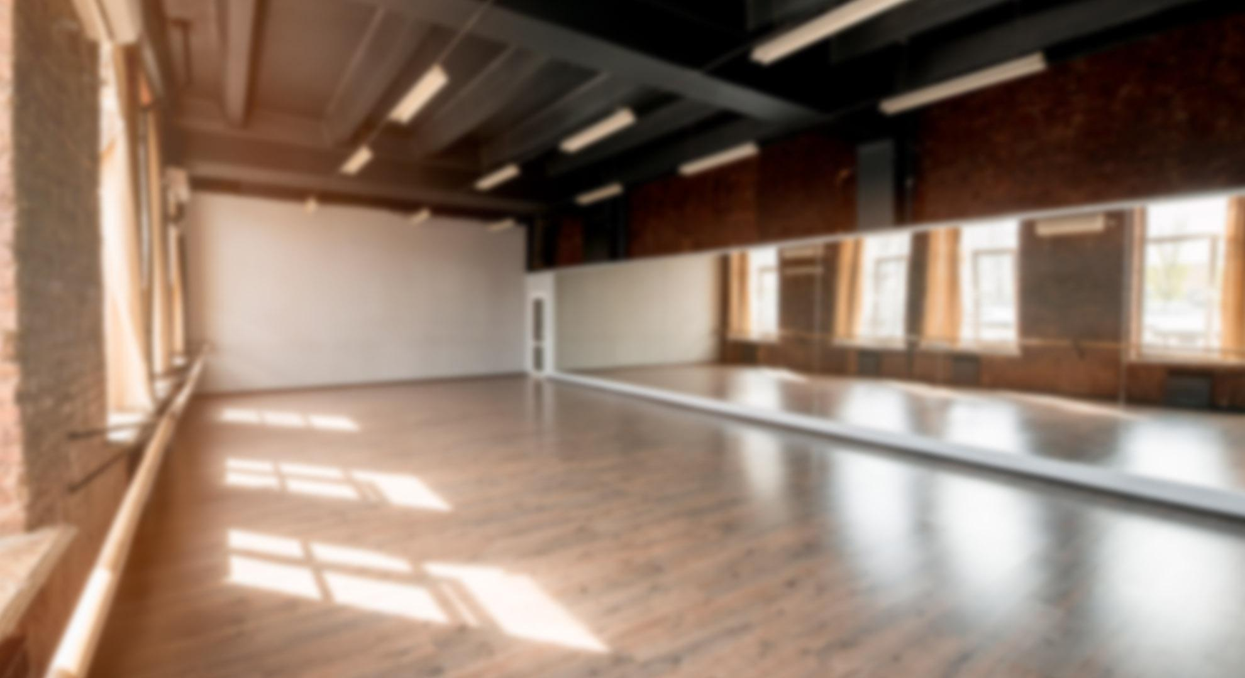

WELCOME TO THE PATTERNS COMPANY
Here is where your presentation begins

Slide 2
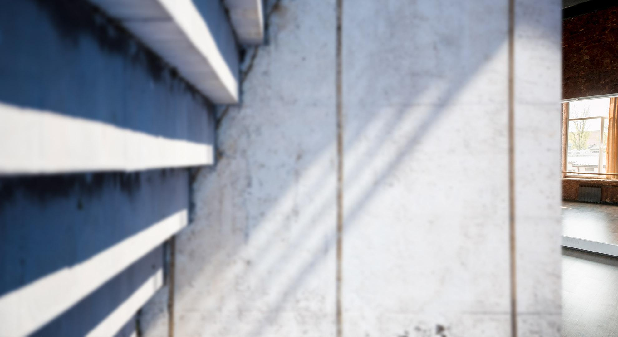
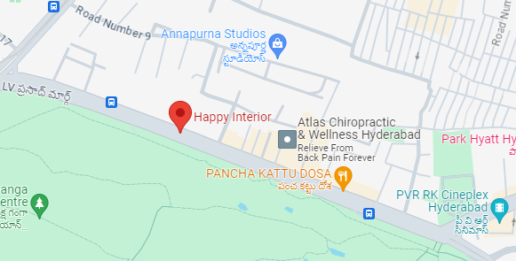

Geographic Location : Pragati Nagar
https://www.happyinterior.in/
Pragati Nagar, Hyderabad, Pin-500090 Working hours: Mon - Sunday 9:00AM - 6:00PM

Slide 3

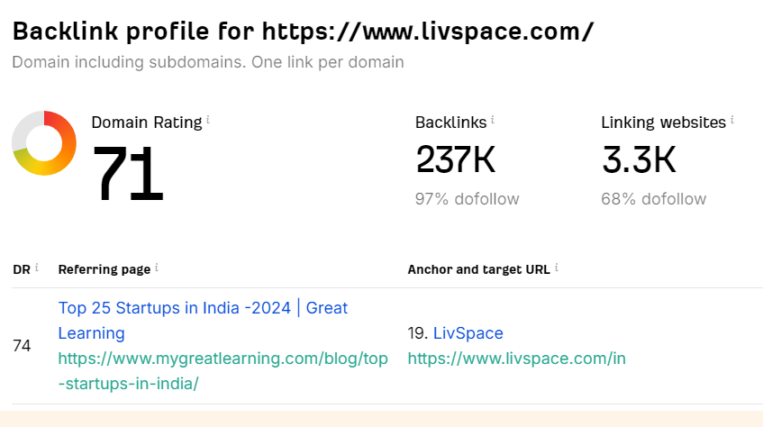
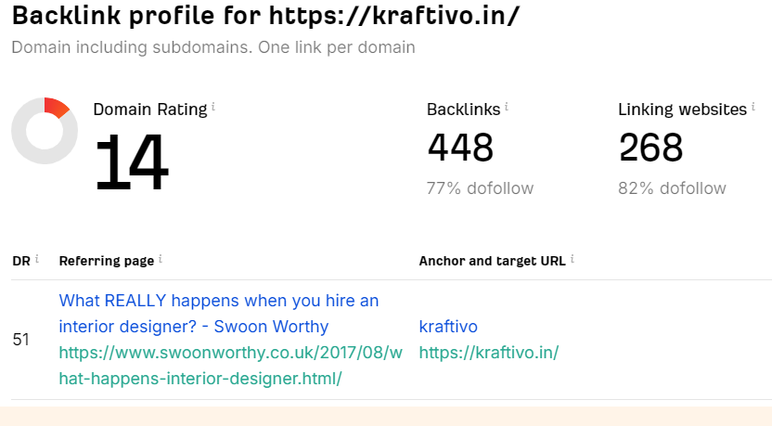
Competitors In Pragathi Nagar
livspace
kraftivo

Slide 4
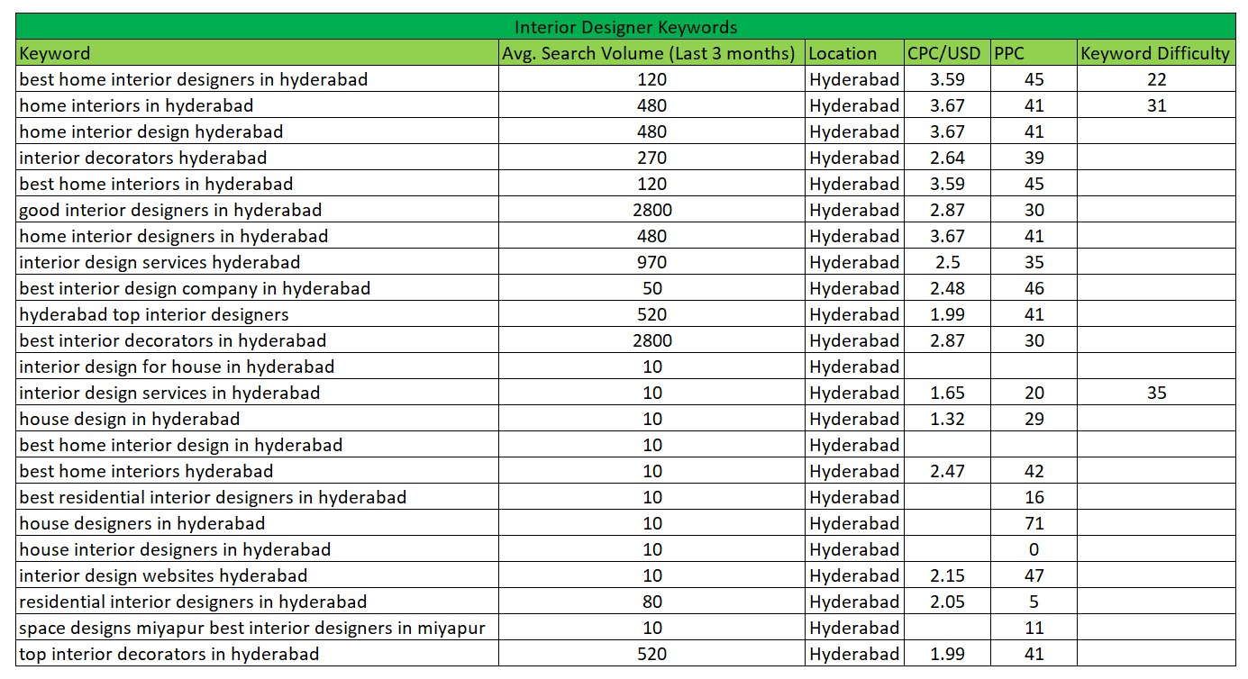
Keywords

Slide 5

Social Media Marketing
Monthly Social Media Postings In Facebook,LinkedIn, Instagram, YouTube & Twitter
20 Postings Per Month
4 Reels Per Month

Slide 6


Meta Ads And Google Ads
We Will Also Run Meta And Google Ads.
We Will Also Give 30 Reviews To Your Google My Business Profile.

Slide 7
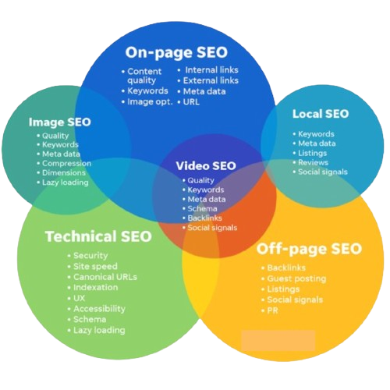
Our Mission To The
Happy Home Interiors
Daily SEO Submissions
120 Backlinks Per Day
24 Working Days
120*24=2,880 Backlinks Per Month

Slide 8
Thank You!
Do you have any questions?
info@thepatternscompany.com
+91 8500693113
thepatternscompany.com

